Slide 1
EL VISTA Webinar

Slide 2

IAER Brainstorming
Recap of WREIC

Slide 3

Cerebral Visual Impairment
Major Topic for the Conference

Slide 4

New Perspectives
Corinna Bauer –
  New insights in neurology
Linda Lawrence –
  New insights into diagnosis
Deborah Chen –
  New resources for practitioners
  Cathy Smyth
    Tactual Development

Slide 5
Major Take-aways (Corinna Bauer)
CVI is varied and complex because:
Many structures in the brain contribute to vision
Neurodevelopmental Timelines
Many developmental components contribute
    Nerve health
      Connections
      myelinization
    Blood supply

Slide 6

Visual System
There are many components to a complete visual system
Symptoms present quite uniquely in people
Optic Track
Visual Pathways
Field of Vision
Color perception
Form Vision

Slide 7
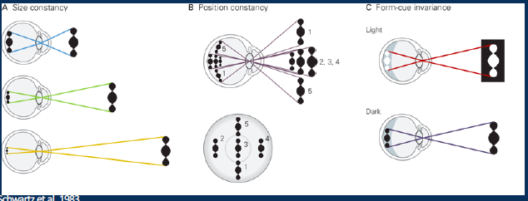
Inferior Temporal Cortex
Cells are selective for certain types of stimuli (objects, faces, etc.)
Invariant to size, position, and reflectance
  Size constancy
  Position constancy
  Form-cue invariance

Slide 8
More on the Visual System
Agnosia
  Stored knowledge
  Putting parts together to see the whole
  Object recognition
    Develops over time (size invariance develops before viewpoint invariance)
  Visual Scene
    Low Level – color, contrast, movement
    Mid-level – shape discrimination, depth, object motion cues
    High-Level – Object identification
  Facial recognition

Slide 9
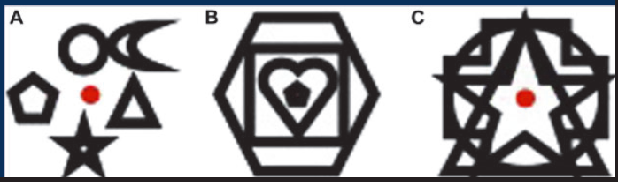
Dorsal Stream
Simultaneous Object Perception
  Simultagnosia

Slide 10
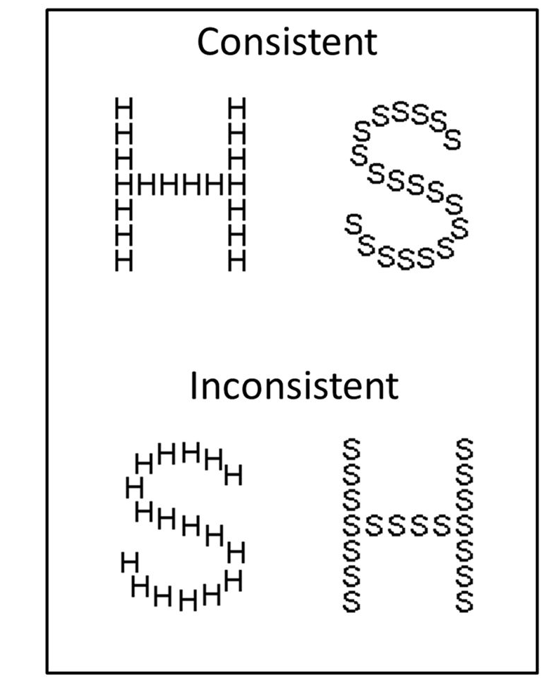
More on Dorsal Steam
Spatial Processing
  Depth perception
Spatial Navigation
Local vs. Global Visual Processing
  Local until about age 6
  Then Global

Slide 11

Neuroplasticity (Bauer Continued)
Continues to be supported by the literature
Environmental Enrichment matches our skillset
Hard to measure – easy to fool
  Uncertain extent to reorganization in neural tissue
  Limited research
  Currently only correlation analyses

Slide 12
Assessments
CVI Range
  Limited reliability
  10 Characteristics
  Used to monitor change
The 5 Questions
  Has Validity
  Used for screening
CVI Inventory
  Good validity and reliability
  54 Questions – Structure History taking
  Used for identifying children with CVI
CVI Questionnaire
  Reliability and validity
  47 questions
  Screening tool
L-POST
  Reliability and Validity
  On-line test
  Evaluates mid-level visual perception

Slide 13
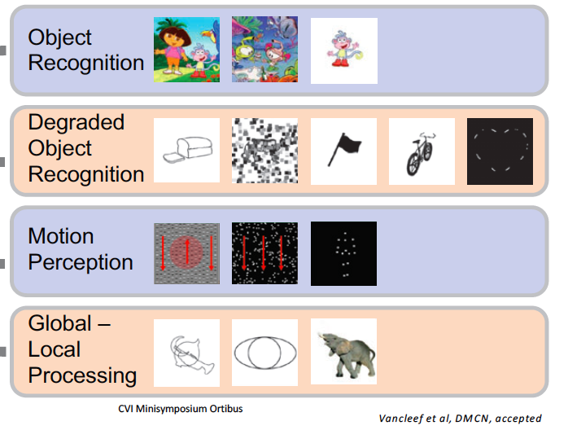
CVIT – 3-6: Children’s VI Test
  Has Reliability and Validity for CVI
Consists of 4 subtests
Try it out on-line at
https://psytests.be/clinicians/test-centrum/cvi-t.php

Slide 14
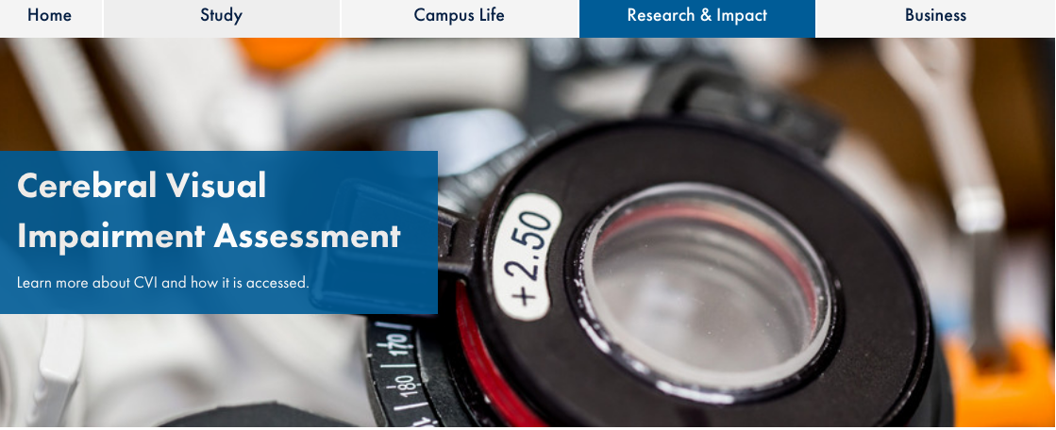
More Assessments
Cerebral Visual Impairment Assessment
  Ulster University Website
Teach CVI
  Website with various tools
  Screening tools
  Literacy
L-94
  Some validity for CVI
  Perceptual battery
Neonatal Assessment Visual European Grid (NAVEG)
  Infant Screening

Slide 15

Major Take-Aways (Linda Lawrence)
Some suggestions given prevalence of hemianopia in children with CVI
  Larger text for spotted loss
  Smaller for large field loss
  Slanted or column text
  Marking and of words
  Window Tint / line guides
  Check out Brain Recovery Project
    Has much on literacy

Slide 16
Major Take-Aways (Deborah Chen)
Provided a functional vision assessment checklist
  NMSBVI is already using this tool and loving it
Provided a document of tips for intervention
Integration within daily routines. Social Emotional relationship is key
Mention of Acoustical Highlighting

Slide 17
Major Take-Aways – Catherine Smyth
Anchor Center Tactile Development Rating Scale
Offers a vehicle for assessment and progress monitoring

Slide 18
O&M Birth to three
I did not attend
This is the NMSBVI 0-3 assessment tool
Recently had reliability and validity done

