Slide 1

Frequency, Intensity, Duration,
Oh My!
Tracy Meehan, DTH
Sara Edwards, DTV
Mini Camp 2018
The contents of this presentation, were developed under a grant from the US Department of Education, #H325140108. However, those contents do not necessarily represent the policy of the US Department of Education, and you should not assume endorsement by the Federal Government.

Slide 2
What we’ll cover today:
Justifications: when, how, and who does what
Determining services
  what factors are used for making recommendations?
Small group discussions with case histories

Slide 3
All on the same page:
Frequency – how often ( 1 wk)
Intensity – how long each session
Duration – every 6 months
Walk the walk and talk the talk
Notes:
Definitions

Slide 4
Illinois Provider Handbook
Pull it up--

Slide 5
EI Provider Handbook
Chapter 3.10.7
Authorized Frequency, Intensity, and Location of Services Adherence Recommendations for goals, outcomes, and strategies for services that include
frequency, intensity, and location will be determined at the IFSP meeting in collaboration with the child’s family. These recommendations are based on the family’s identified priorities and concerns and the Principles of Early Intervention. It is inappropriate for any EI Provider to approach a child’s family to discuss eligibility for EI services and/or recommendations for frequency, intensity or location of services prior to the IFSP meeting. EI Providers may not discuss the results of evaluations and assessments with families prior to the meeting. Prior to making any changes to an IFSP such as increasing/decreasing the frequency or intensity of services that were originally identified as a need on the IFSP or changing the location from an offsite to an onsite location, an IFSP meeting must be held to discuss the recommendation and justification for the change. The Service Coordinator must facilitate the meeting and the parent(s) R12/2016 16 must be present. To request changes to existing authorizations, the Developmental Justification to Change Frequency, Intensity and/or Location form must be completed.

Slide 6
Show of hands:
Who has written a justification in the last 2 years?
Who had had to re-write that submitted justification because it wasn’t complete?
What resources have you used for writing these?

Slide 7
There are reasons for changes:
Location change—from home to clinic or another setting
Frequency – how often will that child and family be seen
Intensity – how many minutes per session

Slide 8
Not good reasons to request change
Because child has greater than 50% delays
Because the child needs more opportunities to practice with you
Because the child isn’t making progress
If change in location is requested—what other natural environments have you tried already or why aren’t those environments suitable
Because the parents want it
Because the child won’t perform or carryover with the parent—only when you are there

Slide 9
When to Request and who attends the mtg?
If changes are requested within the first 3 months after the initial IFSP—whole evaluation team must be present
If exceptional circumstances prevent physical attending of the meeting, call-in arrangements should be discussed with SC
If changes are requested after the original IFSP then the current team is invited. Parents and the person requesting the change must be present with the Service Coordinator
Always the person writing the justification is present

Slide 10
Written Developmental Justification of Need: PROCESS
Providers write up the appropriate form and submit to the SC.
SC will convene an IFSP meeting.
If changes are being recommended after the first 3 months services have been delivered:
current multidisciplinary team must participate and team consensus
parents must agree

Slide 11
Other sections to review:
5.5: Developmental Justification of Need
Attachment 6: Written Developmental Justification of Need - form to complete

Slide 12
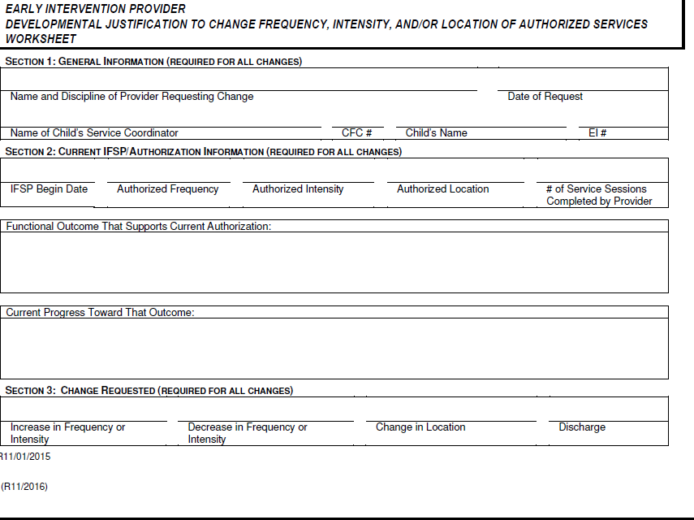

Slide 13
Principles of Early Intervention
Where do you keep this document?
Take out the Written Developmental Justification of Need

Slide 14
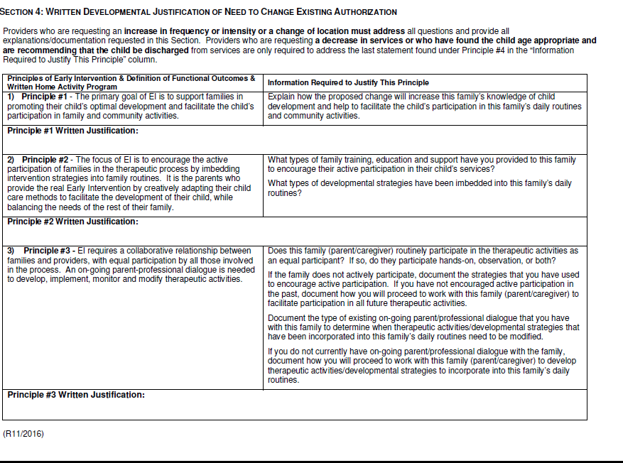

Slide 15
One principle from the Section 4 Handbook
2) Principle #2 - The focus of EI is to encourage the active participation of families in the therapeutic process by embedding intervention strategies into family routines. It is the parents who provide the real Early Intervention by creatively adapting their child care methods to facilitate the development of their child, while balancing the needs of the rest of their family.
What types of family training, education and support have you provided to this family
to encourage their active participation in their child’s services?
What types of developmental strategies have been embedded into this family’s daily
routines?

Slide 16
Principle 2: Written Justification/Vision
The focus of EI is to encourage the active participation of families in the therapeutic process by embedding intervention strategies into family routines. It is the parents who provide the real Early Intervention by creatively adapting their child care methods to facilitate the development of their child, while balancing the needs of the rest of their family.

Slide 17
Principle 2-Written justification/Hearing
Listening skill development is a sequential process tied to other developmental growth. xxxxxx needs to be able to detect sound, identify and name sounds, discriminate different sounds and then use this listening for understanding. This development of listening skills does not automatically occur when new assistive equipment is worn. Joint attention, eye gaze, making choices, localizing sounds, having names for sounds are all developmental strategies that will be incorporated into xxxxxxx learning opportunities.
xxxxxx has not had clear access to sounds in his environment. He has shown some awareness of sounds when they are loud and when the speaker is close to him. With the improvement in some of his motor skills, his interest in locating sounds has also increased. He will need support while he learns to develop these listening skills using his new hearing assistive technology. Having clear access to all frequencies of sound is the first step toward the listening and spoken language outcome his parents have for him.
Notes:
From 2 x month to 1 x week

Slide 18
Tips for writing
Each of the 7 principles must be addressed—either principle by principle or in narrative format SHOW EXAMPLES
Use the sample information questions on the form in the handbook—what are you currently doing? Paint a picture for the reader
Don’t simply repeat the principle—descriptive

Slide 19
Switching to deciding services:
What factors go into a good recommendation?
Is there some commonality among our field as we make these recommendations?

Slide 20
What goes into making decisions –
ongoing services
Availability
Geographical Location of family
Diagnosis of child/Severity of vision loss
Age of the child
Other services/disciplines
Family priorities

Slide 21
Goal in IFSP development:
To develop a home program that parents can follow and build their own skill set
Based on caregiver concerns and priorities
Not to teach the child to demonstrate skills when you are present

Slide 22
When decreasing
Possibly only need a short increase and then child is back on track
CFC5—doesn’t require a discharge meeting or a meeting to decrease one provider’s services if there are more than one person on the team. The decrease happens with the parents and then is discussed at the next 6 month review
All CFC’s operate a little differently

Slide 23
Case Reviews: Three Questions
What does the assessment tell you about the child’s strengths and needs?
What services would you recommend?
What frequency and intensity would best serve this family?
Record your table’s ideas about what factors should be considered when making these decisions. Write them down—then large group will share

Slide 24
Case Review: #1 Jessica
Diagnosis of Lebers Congenital Amaurosis (LCA)
5.5 months old
mom works 2 days a week and home 3 with older sister 2 ½
healthy and no meds. Passed newborn hearing screening
Ocular report: light perception only, quiets when light goes on, not tracking horizontally or vertically, no eye contact or eye shift
Using auditory and tactual cues

Slide 25
Case Review: Matthew
8 months old and multiple medical needs
Deaf/blind
home with mother and both parents have some education background
occasionally hospitalized with seizure activity
mild-moderate hearing loss and wears 1 aid on left ear
high myopia and wears glasses
visually attends best to items presented 6-8 inches in front on solid background
can become irritable when over stimulated

Slide 26
Case Review: Callie
11 months old
Diagnosed with seizure disorder
No concerns with hearing
Not meeting milestones
Easily overwhelmed with sensory input

