Slide 1
Early Intervention Vision Summer Mini Camp 2018
Products that Connect Families with
Early Intervention Services
Dawn Wilkinson, Early Childhood Project Leader
American Printing House for the Blind

Slide 2

Parents and Their Infants With Visual Impairment (PAIVI) Second Edition
Designed to help parents and teachers of infants who are visually impaired work together as primary members of the intervention team.

Slide 3
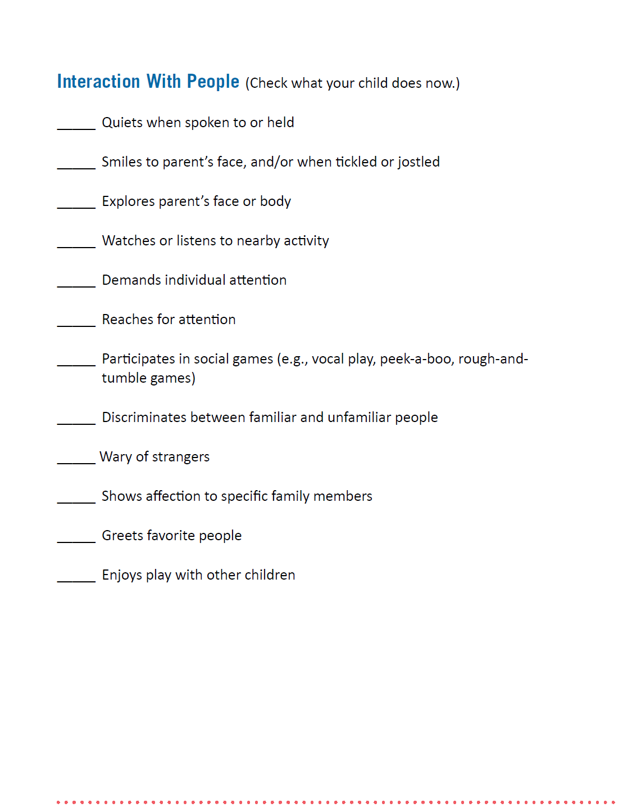
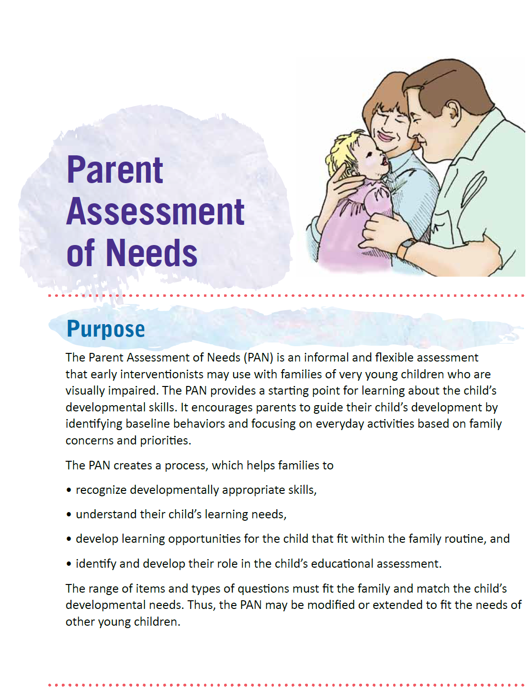
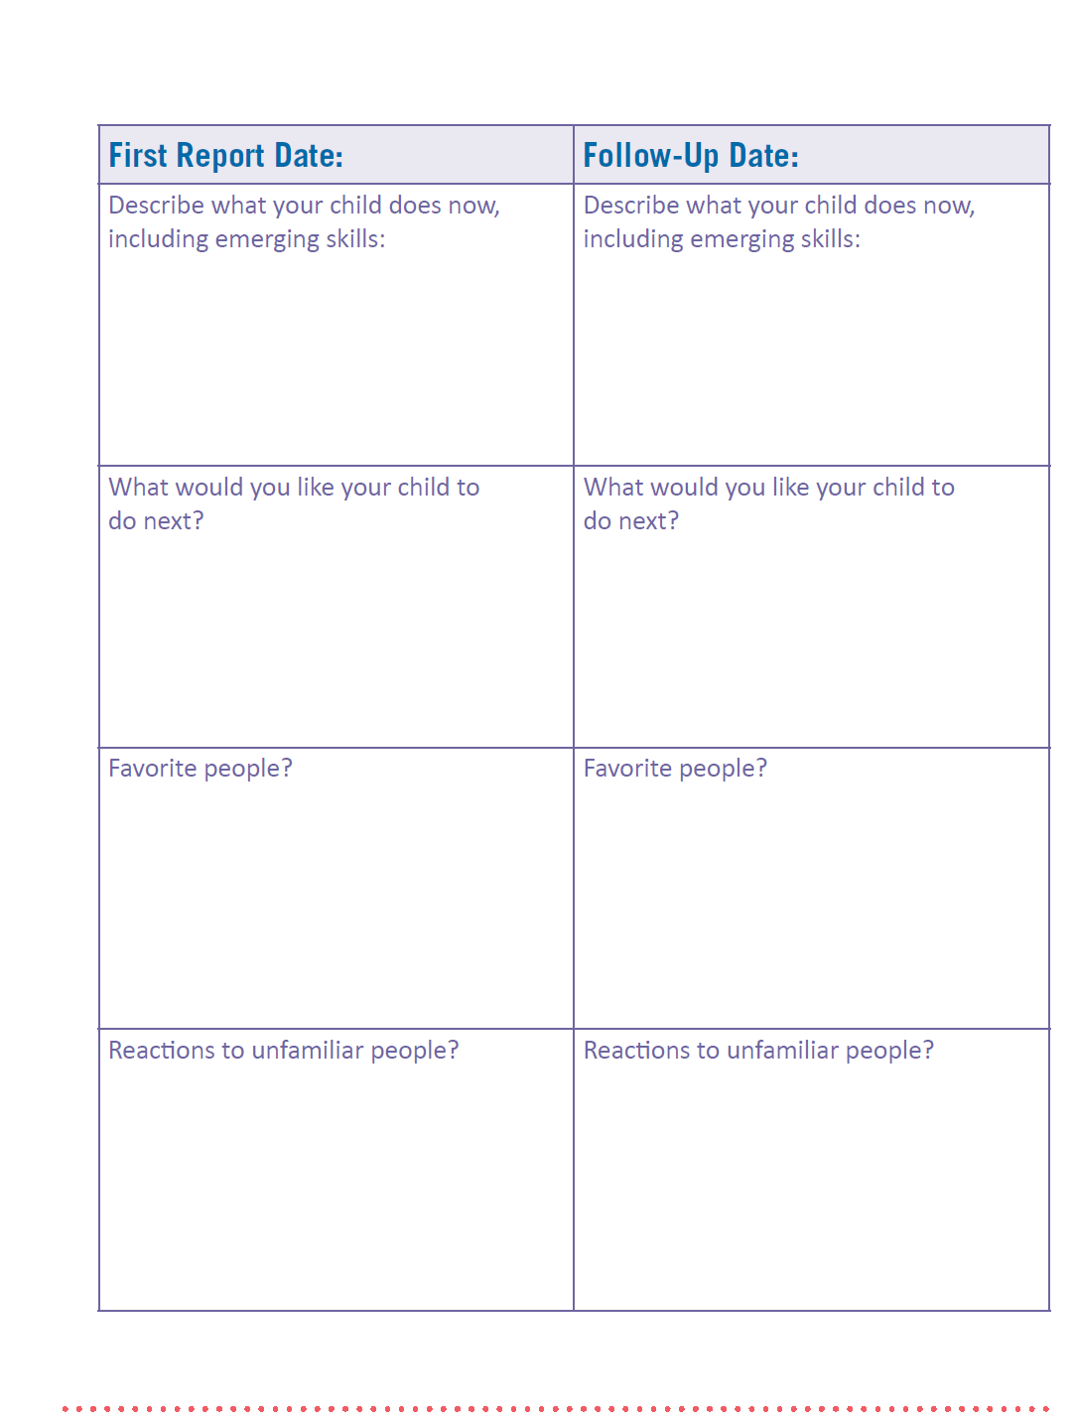
PAIVI
Parent Assessment of Needs (PAN)
Parents and early intervention service providers work together to identify home-based goals
PAN Sample Pages

Slide 4
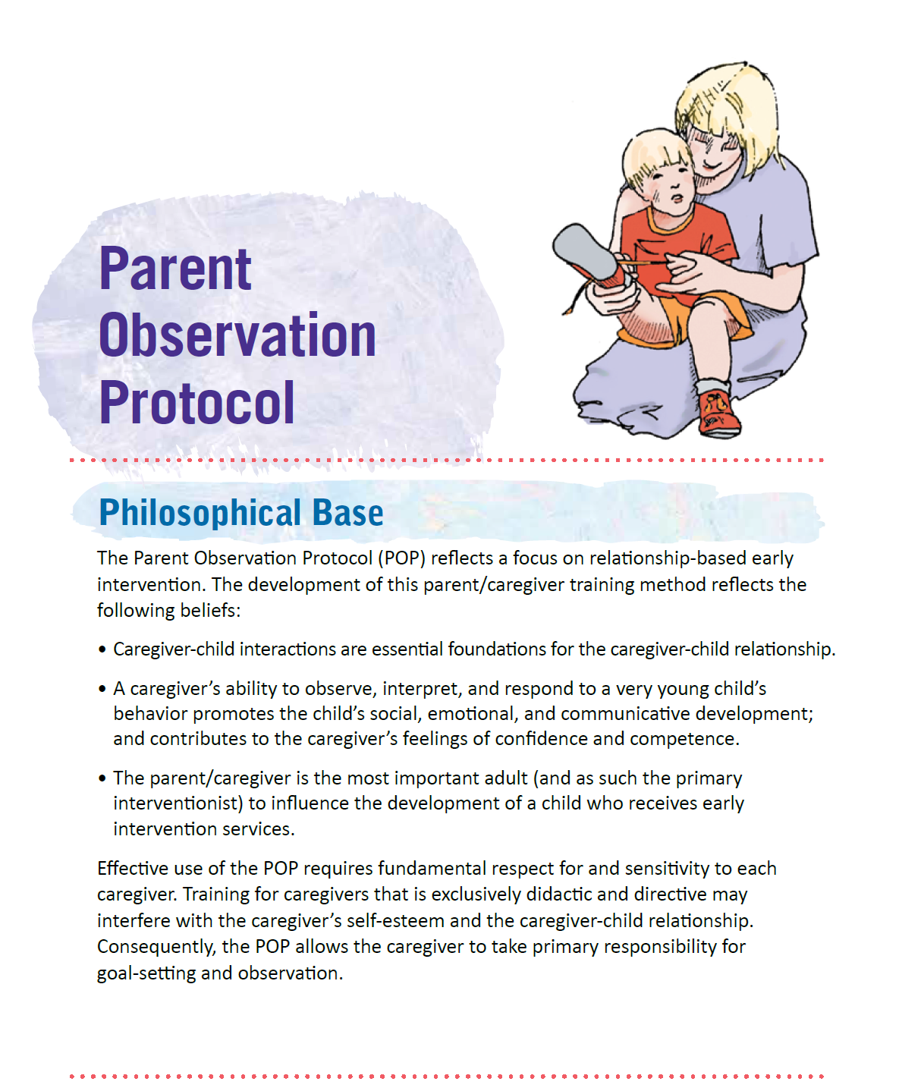
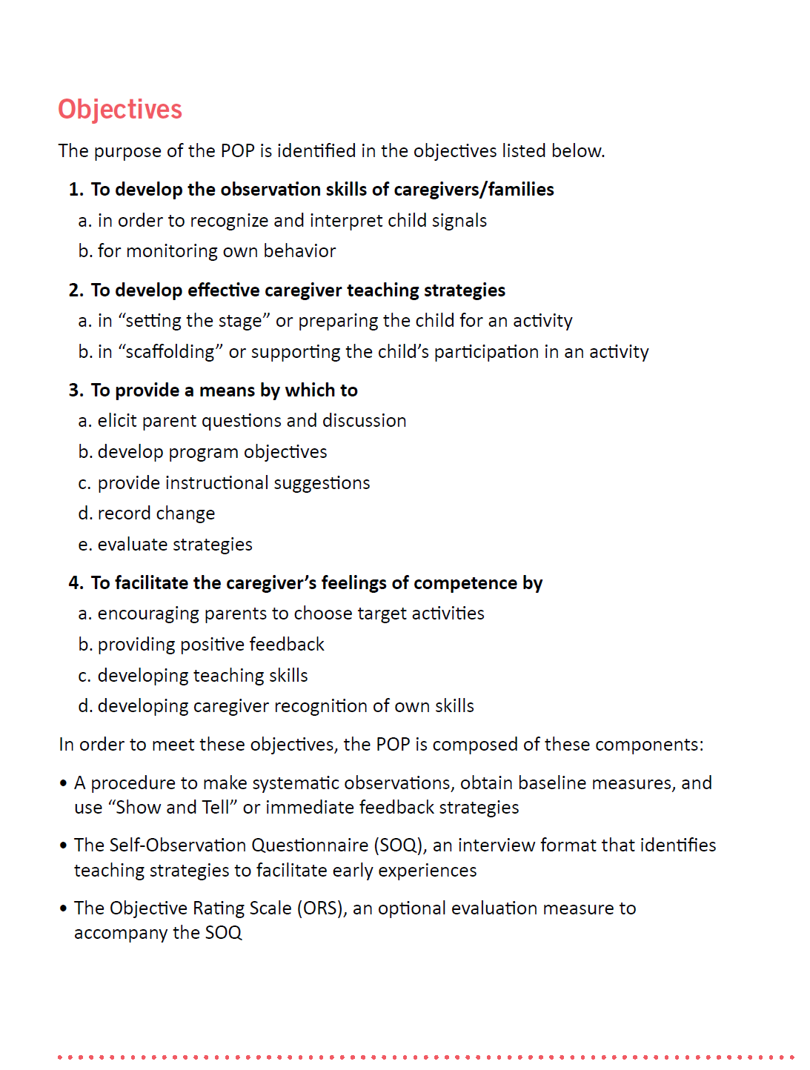
PAIVI
Parent Observation Protocol (POP)
Uses video as a tool for parents to observe themselves and their child during teachable moments
POP Sample Pages

Slide 5
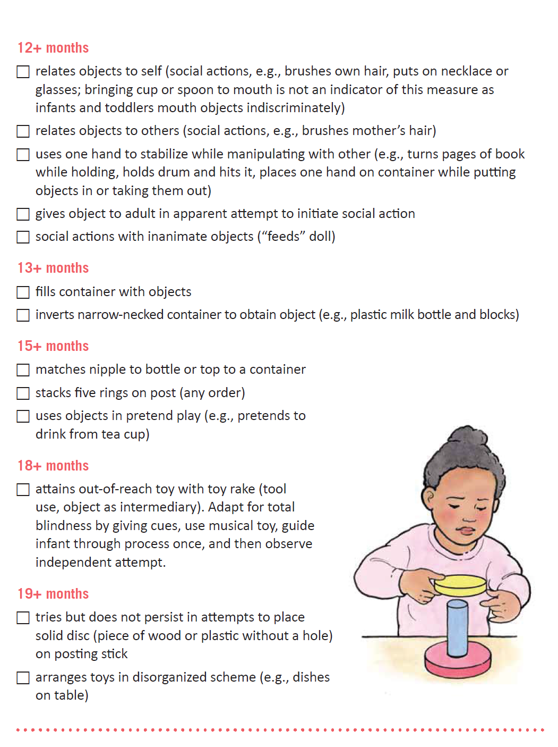
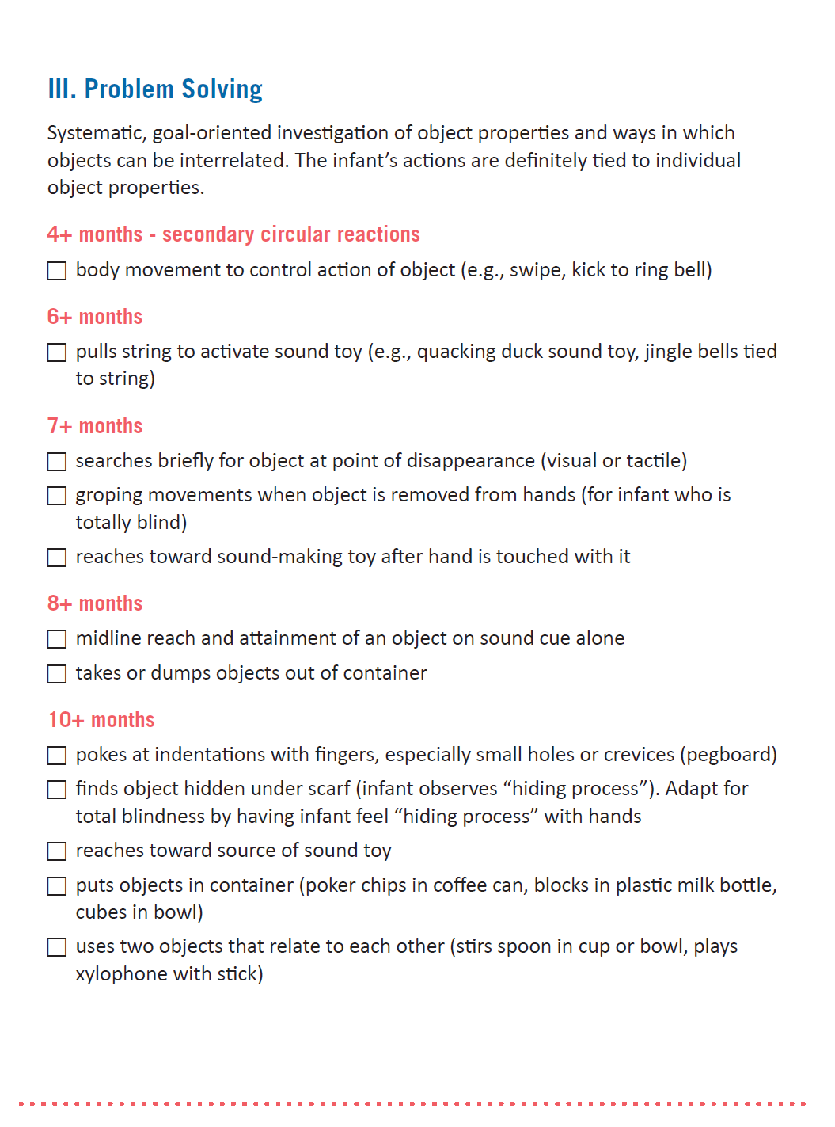
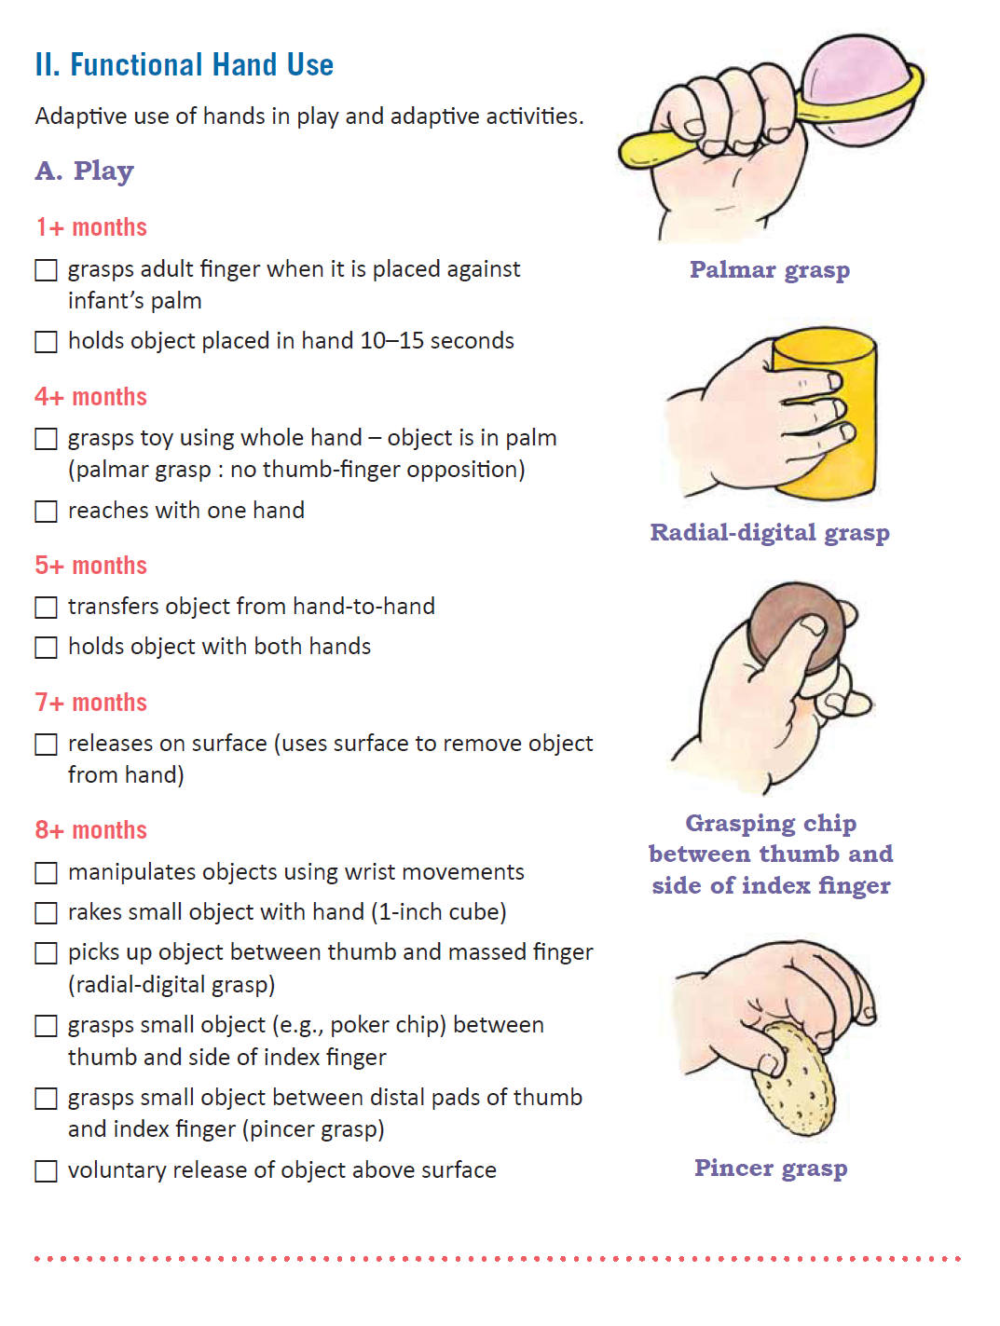
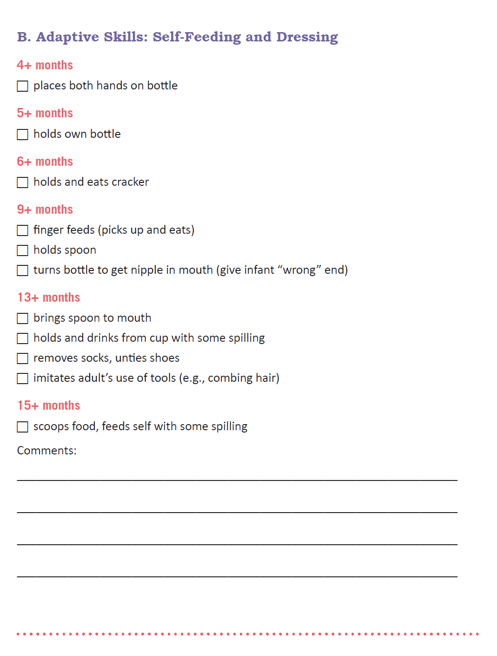
PAIVI
Assessment Checklists
Developmental Vision
Functional Hearing
Functional Communication
Interaction With Objects
Sample Pages from Screening Checklist for Interaction With Objects

Slide 6
PAIVI
Parent Booklets
Learning Together: A Parent Guide to Socially Based Routines for Very Young Children With Visual Impairments
Getting Ready for Preschool: A Parent Guide to Transition

Slide 7
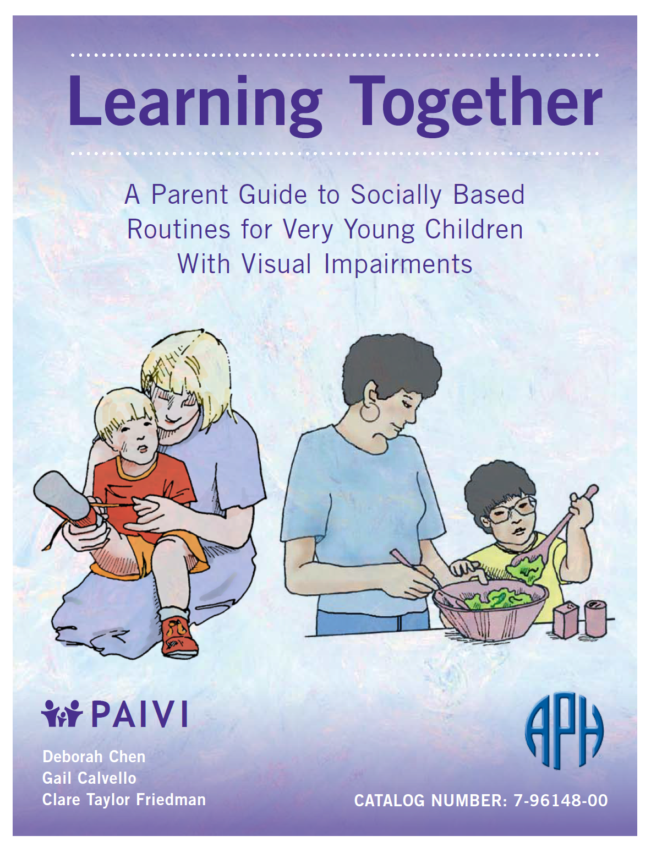
Learning Together
PAIVI – Parent Booklet
Offers strategies for parents to embed learning opportunities within everyday activities: mealtime, bath time, bedtime, playtime, story time, and going out.

Slide 8
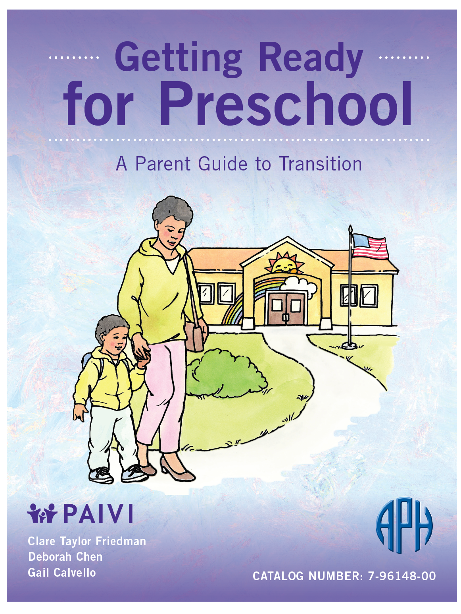
Getting Ready for Preschool
PAIVI – Parent Booklet
Addresses concerns parents may have about transition from early intervention to preschool services

Slide 9
VIPS@Home:
Parent Empowerment Program
VIPS@Home is a three-module program developed from a partnership between APH and Visually Impaired Preschool Services (VIPS).
VIPS@Home: Parent Empowerment Program offers three course booklets for parents that can be studied in the home, making it possible to get information to families at their convenience. These materials offer opportunities for connecting with professionals and other parents for support.

Slide 10

VIPS@Home: Parent Empowerment Program
Emergent Literacy
This course helps parents become comfortable reading to their child with a visual impairment as they learn how to make the story time come alive. Parent learn how to make a story box, adapt books, and create books of their own.

Slide 11

VIPS@Home: Parent Empowerment Program
Power at Your Fingertips
This course provides a concise and family-friendly introduction to braille. Parents can begin to experience the joy of learning braille without the frustration of enormous textbooks.
Parents will learn how to bring braille literacy into their everyday routines and discover numerous resources for child-ready braille materials.

Slide 12
VIPS@Home: Parent Empowerment Program
Special Education: Your Journey to a Successful IEP
This course helps to demystify conferences and paperwork, easing the transition from IFSP to the IEP, and puts parents at ease during the school years ahead.

Slide 13
Laptime and Lullabies: Sharing the Joys of Literacy with Your Infant or Toddler Who is Visually Impaired by Kay L. Clarke, Ph.D.
Kay Clarke is a licensed Teacher of the Visually Impaired (TVI), Certified Orientation and Mobility Specialist (COMS), Early Intervention Specialist, and Preschool Special Needs Teacher who has provided vision services for young children and their families in California and Ohio for over 30 years.
She has additionally served as a part-time instructor with Salus University and the Ohio State University, and developed OSU's Orientation and Mobility Training Program. Kay authored the "Hold Everything" and "Making Sense of Early Intervention" booklets for the Ohio Center for Deafblind Education.

Slide 14
Welcome to Laptime and Lullabies
With a little “thinking out of the book,” you and your little
one can discover literacy activities that are enjoyable and
meaningful to you both. Many parents with young children who are
blind or visually impaired wonder . . .
“When should I begin to read to my baby?”
“How can I interest my toddler in books if she does not see the pictures clearly?”
“Should my young child learn to read braille?”
“What kinds of early literacy experiences can I provide for my child who is visually impaired and has additional special needs?”
Laptime and Lullabies was created to help you answer these and
other important questions.

Slide 15
What’s in the Kit?
Wee-Read-Together Book Bag: “Where’s Little Fuzzy”
This is a print/braille/tactile storybook with an accompanying tips card. Addresses a variety of concepts:
  Texture discrimination
  Under
  Inside
  Behind
  Same/different
  Developing object permanence

Slide 16
What’s in the Kit? (continued)
Wee-Read-Together Book Bag: Butterflies!
This print/braille/tactile storybook also has a tips card and addresses various concepts and opposites:
  Up/down
  On/off
  In/out
  Bumpy/smooth
  Big/little

Slide 17
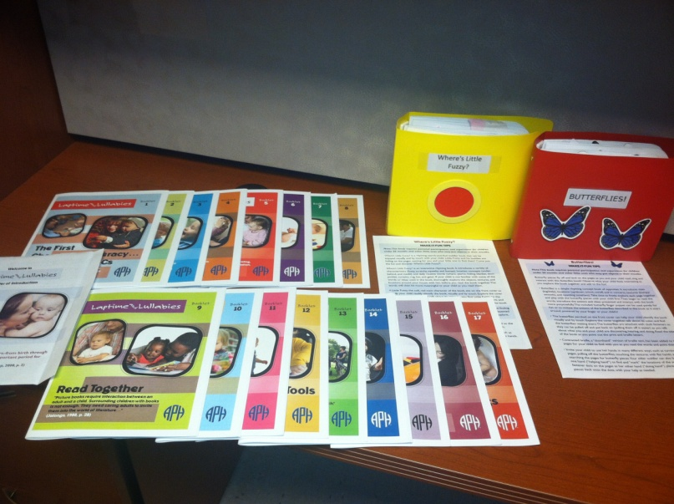
What’s in the Kit? (continued)
The Handbook:
  This is actually a compilation of small booklets to provide a friendly and focused approach. Although no particular sequence is required after booklet 1, the booklets relate to one another in that each focus area helps to develop emergent literacy as defined in booklet 1.

Slide 18
Components of Emergent Literacy from the Handbook
Establish Relationships: Booklet 2
Share Conversations: Booklet 3
Focus on Vision: Booklet 4
Grow Listening Skills: Booklet 5
Enhance Touch: Booklet 6
Partner in Play: Booklet 7
Explore the World: Booklet 8
Read Together: Booklet 9
Investigate Books: Booklet 10
Discover Symbols: Booklet 11
Experiment with Tools: Booklet 12
Team Up for Literacy: Booklet 13

Slide 19
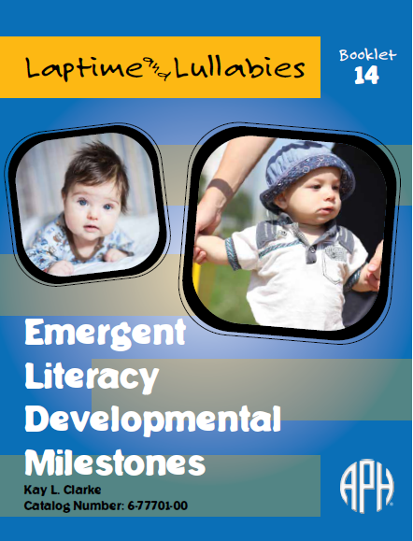
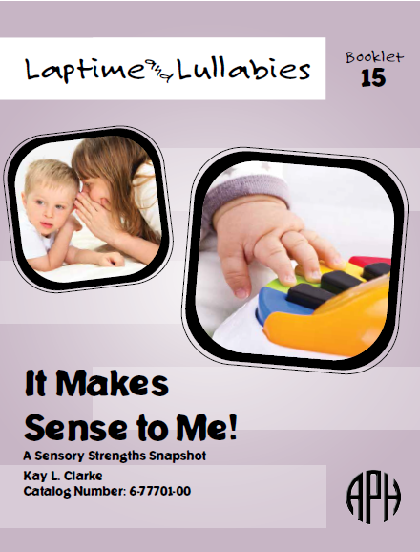
Booklet 14 “Developmental Milestones” and Booklet 15 “It Makes Sense to Me: A Sensory Strengths Snapshot,” in particular, pinpoint the previous 13 booklets. If a parent finds they have a priority in mind, they can then refer to the appropriate booklet for tips and strategies.
Use after Booklet 1 or use to put it all together.

Slide 20

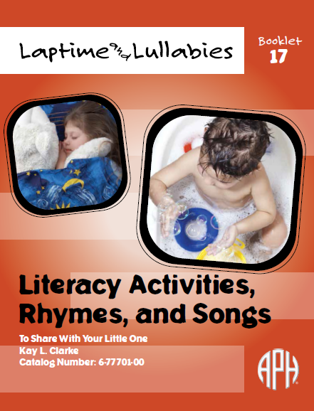
Emergent Literacy in Everyday Fun Activities
Bath time and Bedtime
These recommended interactive books, toys, rhymes, and songs can be
explored by parents at any point!

Slide 21
Highlights of Individual Booklets
Each begins with a helpful quote
Lots of colorful pictures to keep it bright and engaging
Concise and easy to read
Gently encourages reading of the other booklets
A wealth of resources and ideas

Slide 22
What Did Field Evaluators Say?
Laptime and Lullabies was field tested in the Spring of 2016. Materials were sent to the birth to 3 center in Arkansas, and also to Illinois, Colorado, Florida, and New Mexico.
On a scale of 1 to 5, with 1 being not recommended and 5 being highly recommended, how would you rate these materials for use by parents at home, assuming an agency has a loan program or that parents can purchase the kit?
  100% answered 5 (Highly recommended)
Please rate the need for this product on a scale from 1 to 5, where 1 equals very low and 5 equals very high.
  71% rated it a 5; 29% rated it a 4.

Slide 23
Coming soon …
Handbooks will go on sale Fall 2018.

